Slide 1

Object-Oriented Software Analysis & Design (COMP-3220) Lecture 8 Template Method Pattern
School of Computer Science
Faculty of Science
University of Windsor
Dr. Saeed Samet

Slide 2
Intent
It defines the skeleton of an algorithm in a superclass while allowing subclasses to redefine specific steps of the algorithm without changing its overall structure.
The superclass controls the algorithm flow, while subclasses customize certain operations.

Slide 3
Motivation
In many systems:
Multiple classes perform similar workflows.
The overall algorithm remains the same.
Only some individual steps differ.
Without Template Method:
Code duplication increases.
Common logic is repeated.
Maintenance becomes difficult.
The Template Method Pattern extracts the common workflow into a base class and allows subclasses to customize selected steps.

Slide 4
Problems It Solves
Eliminates duplicated workflow logic.
Enforces a fixed algorithm structure.
Allows controlled customization.
Promotes code reuse.
Supports the Hollywood Principle:
“Don’t call us, we’ll call you.”
The superclass controls the execution flow and calls subclass methods when needed.

Slide 5
Real-Life Analogy
Making Beverages
Suppose we prepare tea and coffee. The general process is:
Boil water
Brew the drink
Pour into cup
Add condiments
The overall process is identical. Only some steps differ:
Tea uses tea leaves and lemon.
Coffee uses coffee beans and sugar/milk.
The recipe structure stays fixed while subclasses customize some steps.

Slide 6
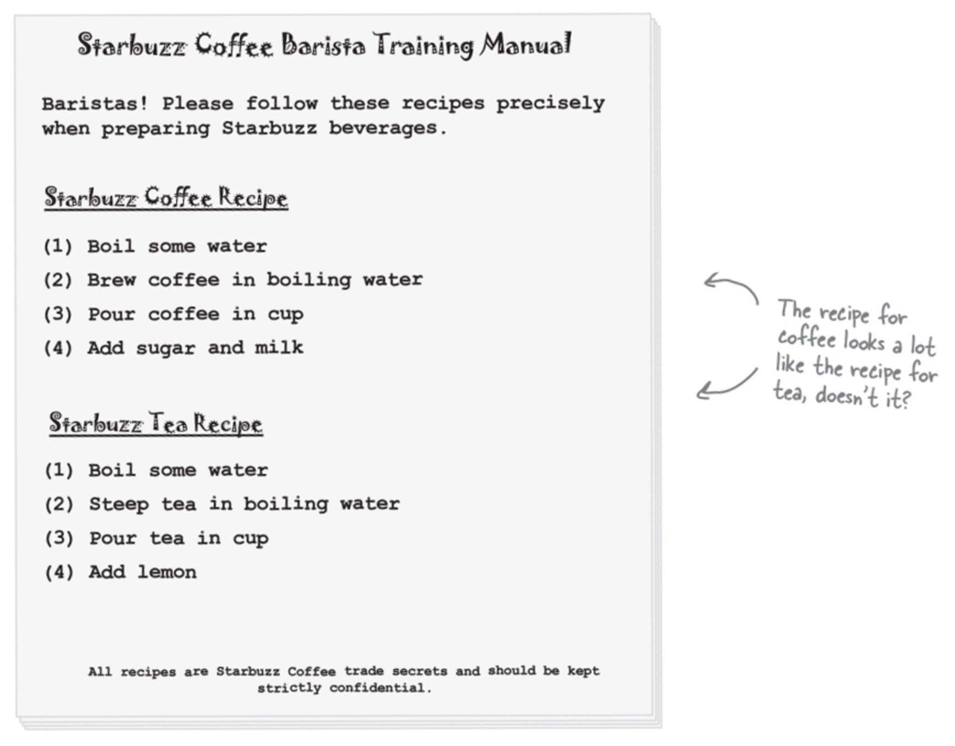
Real-Life Analogy

Slide 7
Template Method Pattern Structure
Main Participants
Abstract Class
Defines:
The template method (algorithm skeleton)
Common operations
Abstract operations to be implemented by subclasses
Concrete Subclasses
Implement the variable steps of the algorithm.
Client
Uses subclasses through the common template method.

Slide 8
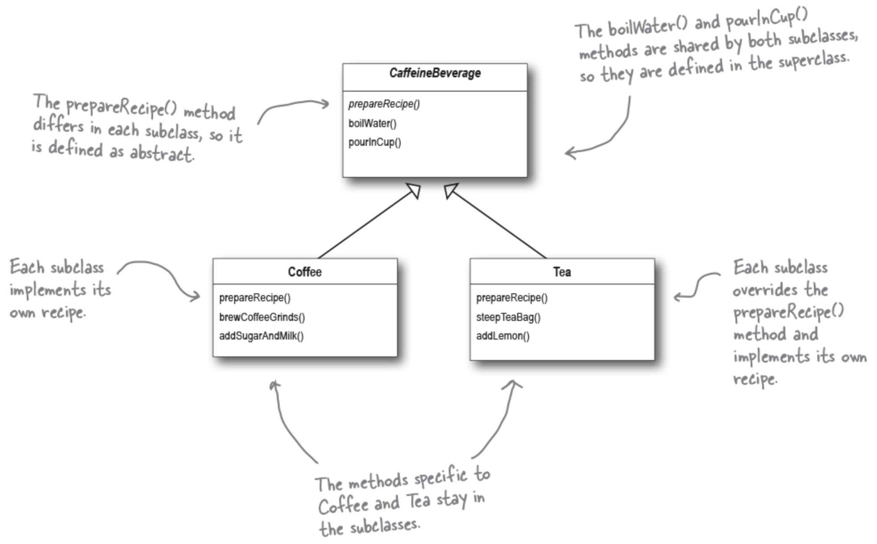
Template Method Pattern – Class Diagram

Slide 9
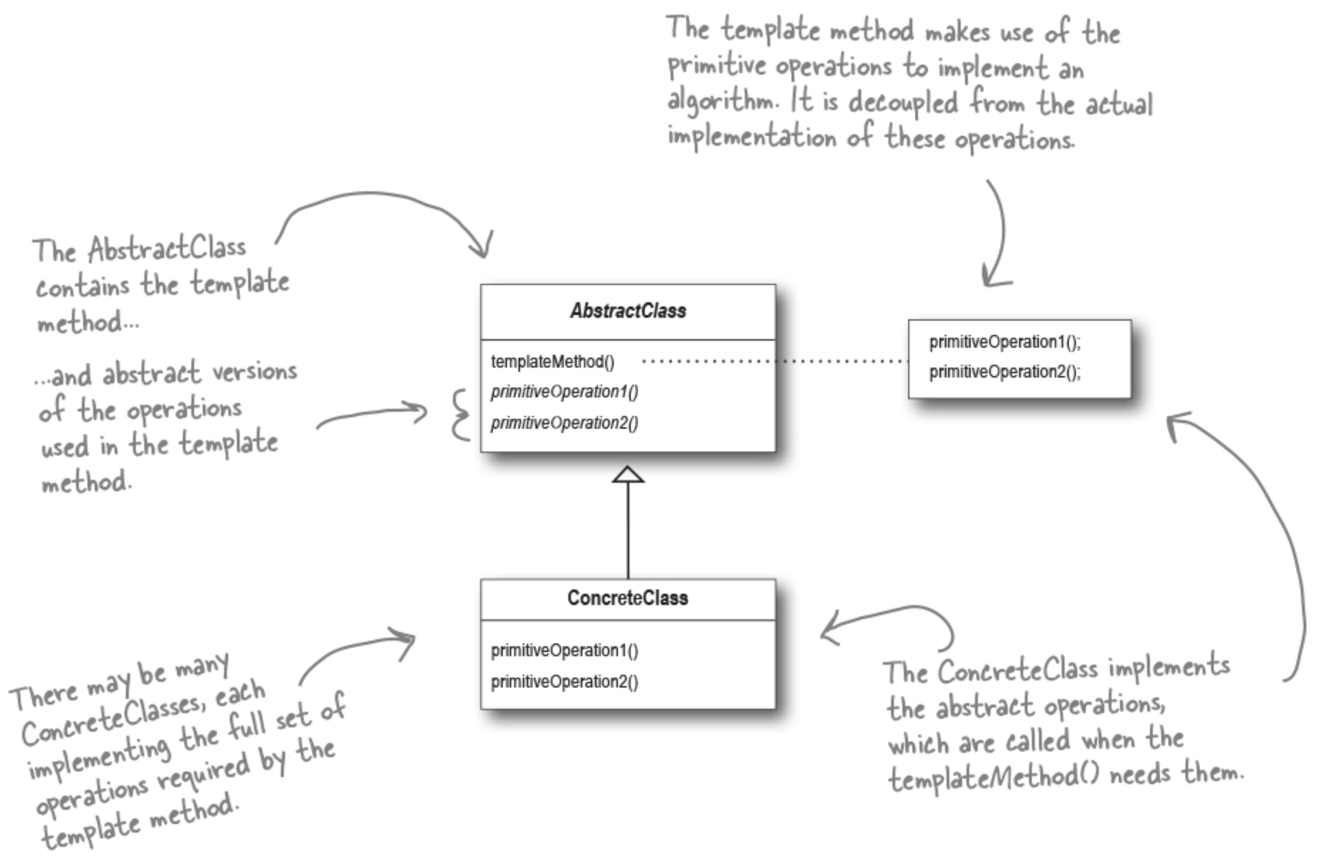
Template Method Pattern – Class Diagram

Slide 10
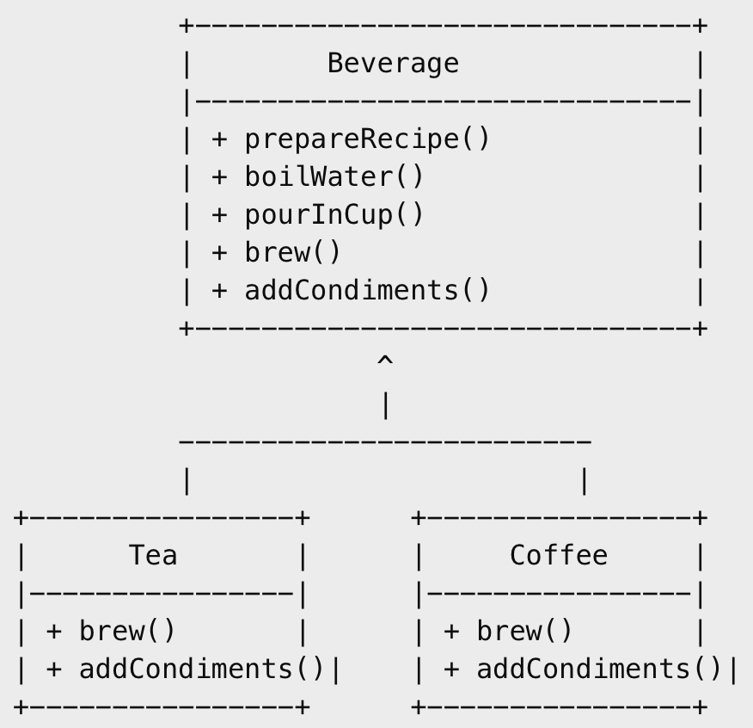
Example: Beverage Preparation System
We create:
Tea
Coffee
Both follow the same recipe structure:
Boil water
Brew beverage
Pour into cup
Add condiments
The differing steps are implemented by subclasses.

Slide 11
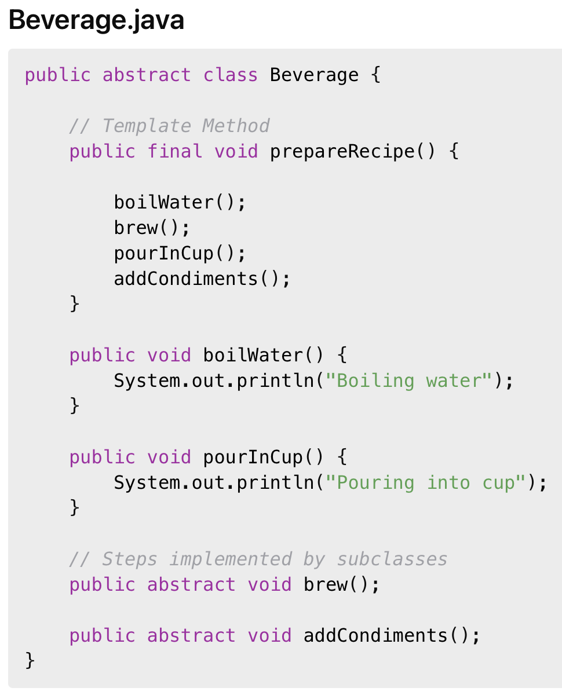
Java Code

Slide 12
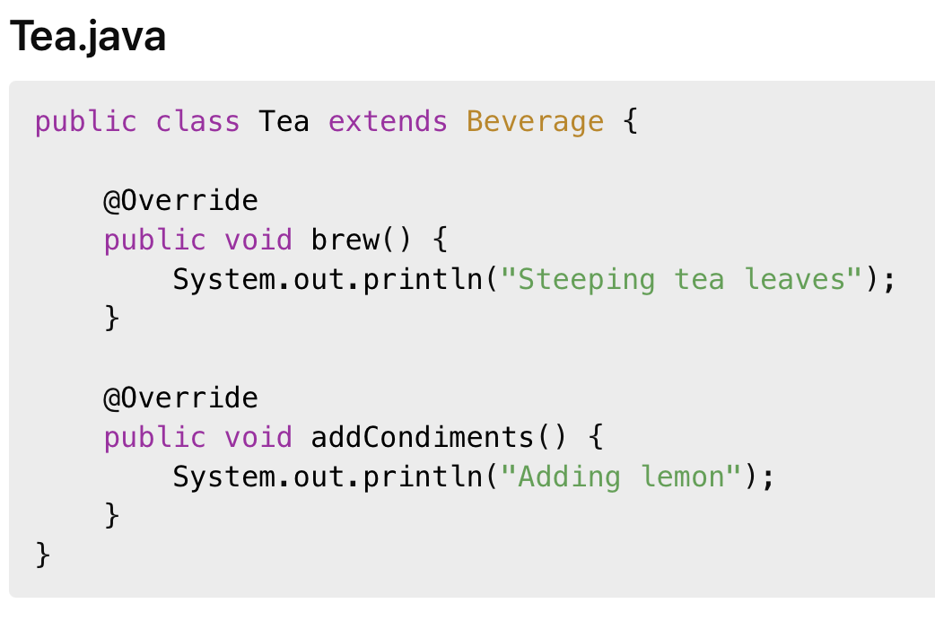
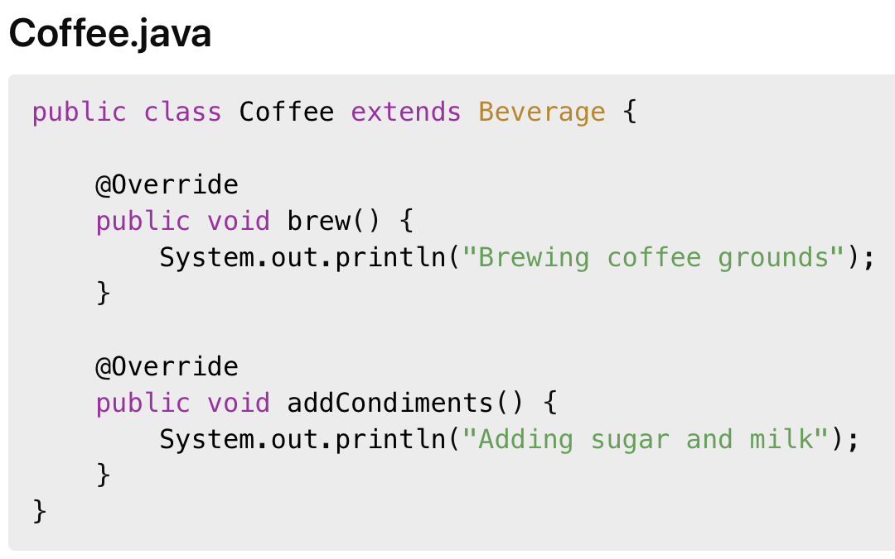
Java Code

Slide 13
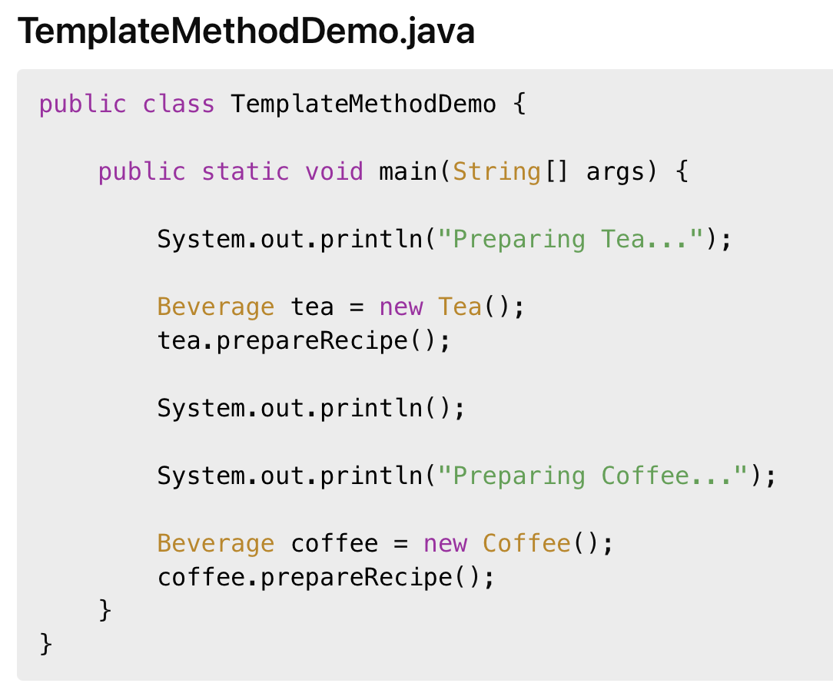
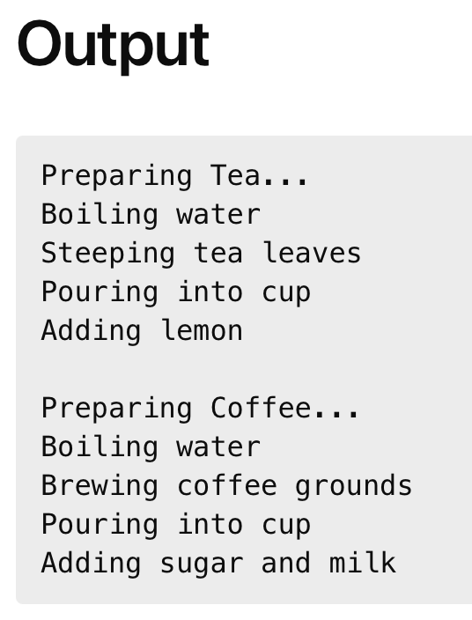
Java Code

Slide 14
Hook Methods
Template Method often uses hook methods.
A hook method:
Is optional
Has a default implementation
Can be overridden by subclasses
Hooks provide flexible customization.

Slide 15
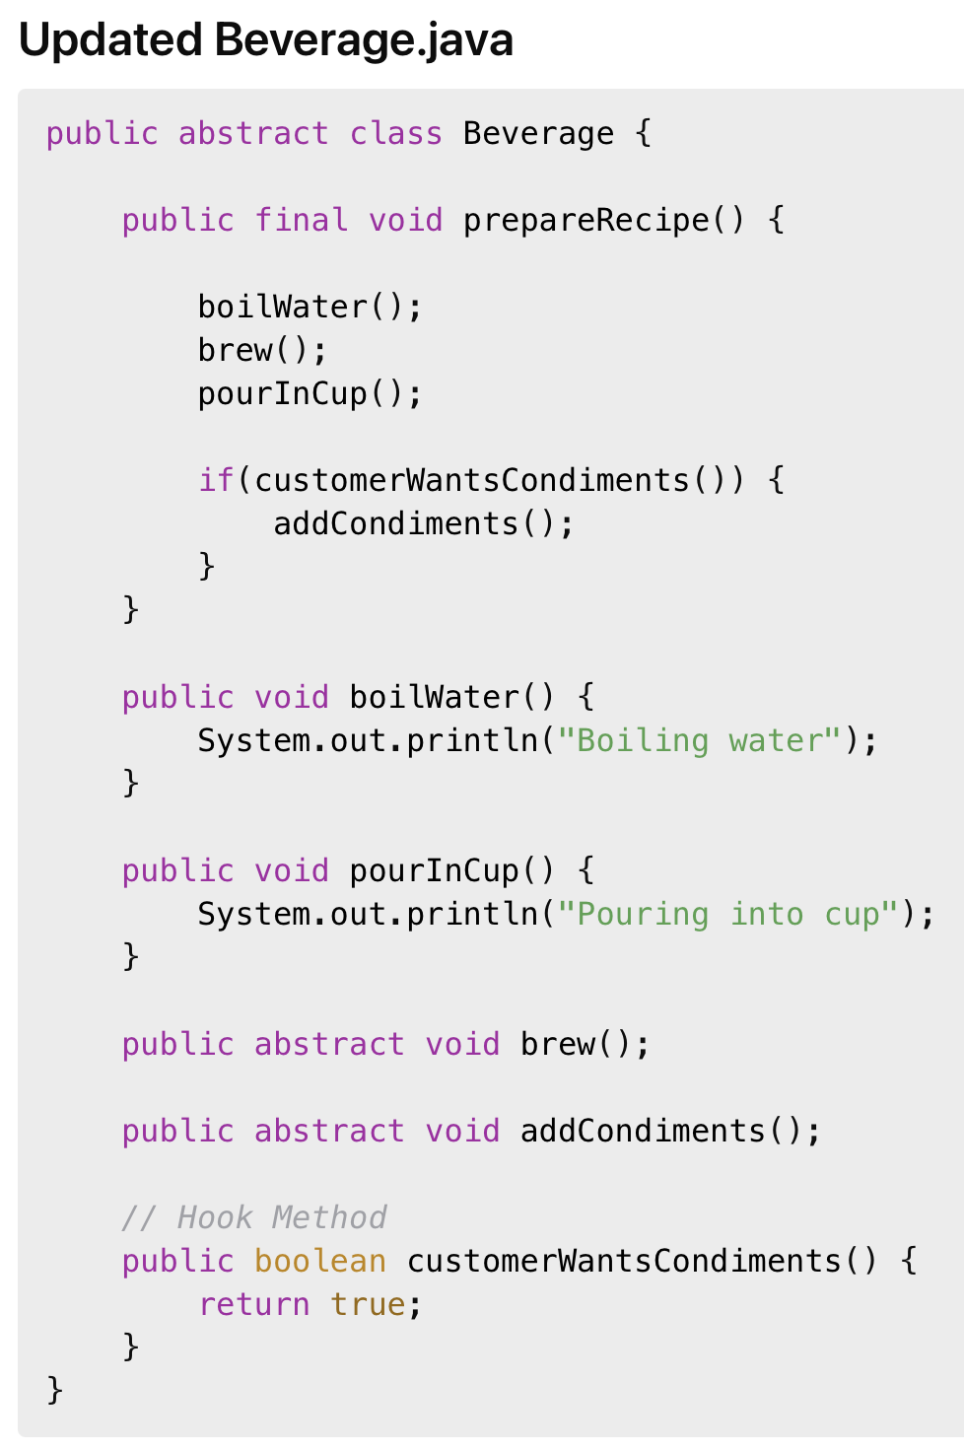
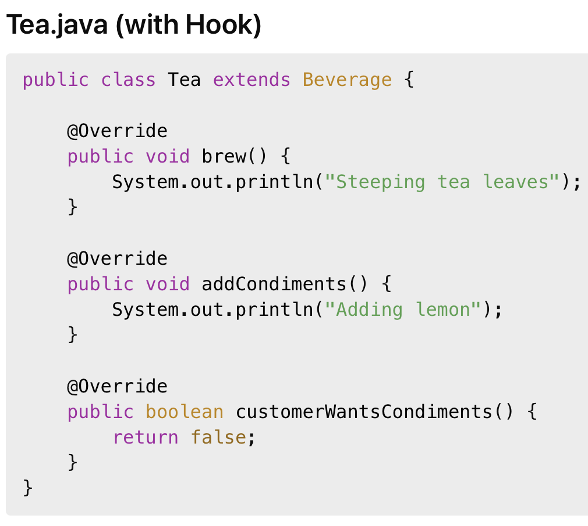
Java Code

Slide 16
Advantages
Promotes code reuse.
Centralizes workflow logic.
Enforces algorithm structure.
Supports Open/Closed Principle.
Simplifies maintenance.

Slide 17
Disadvantages
Inheritance-based design can increase coupling.
Large abstract classes may become difficult to maintain.
Deep inheritance hierarchies may reduce flexibility.

Slide 18
Use Template Method Pattern when
Multiple classes share the same algorithm structure.
Only some algorithm steps vary.
You want to avoid duplicated workflow code.
You want to control execution order.

